Slide 1

Final Project Presentation
Niklas Harald Rosseck
202400384

Slide 2
Structure
How it started?
How is the current status?
What still needs to be added?
What are optional features?

Slide 3

How it started?

Slide 4
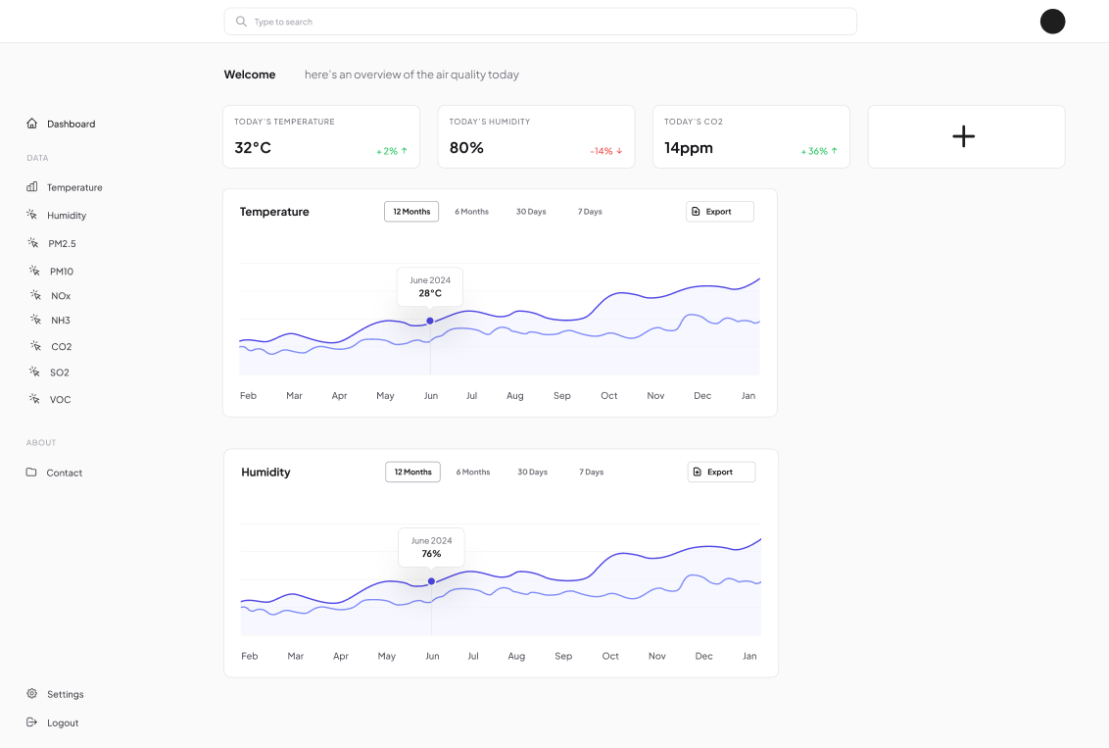
A Figma Prototype

Slide 5

How is the current status?

Slide 6
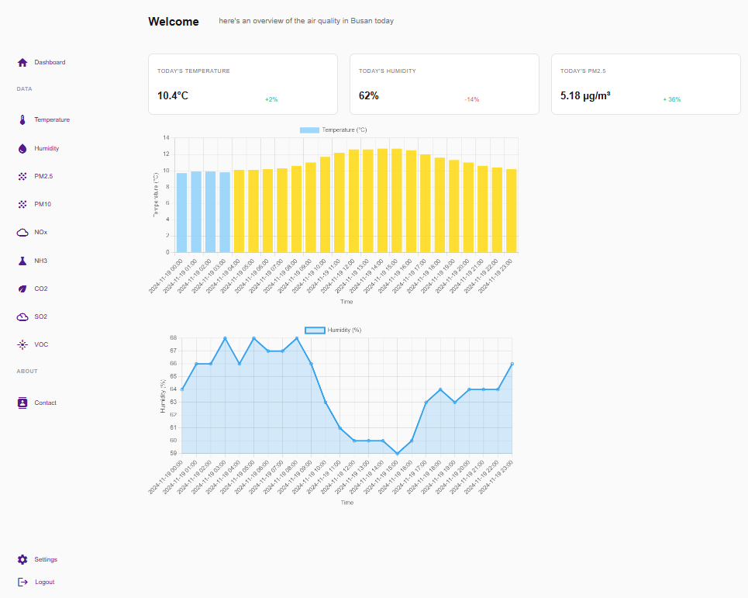
The current status
Data derived from a WeatherAPI
Icons derived from Google
Charts displayed with Chart.js

Slide 7
Demo
https://niklasrosseck.github.io/AirQuality/homepage_test.html

Slide 8
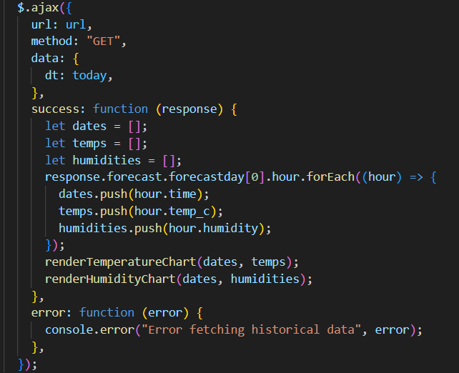
The API code

Slide 9
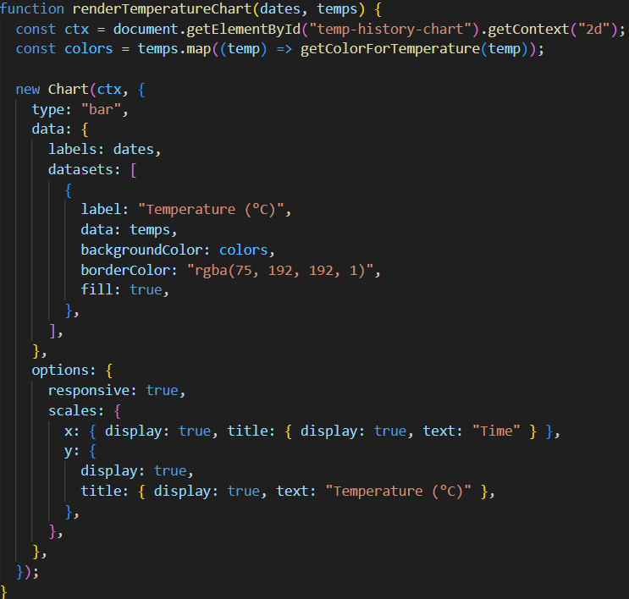
The chart code

Slide 10
What still needs to be added?
Pages for all different air quality values
Reading data from CSV
A footer
Making it adaptive to various screen sizes
Documentation (README.md)

Slide 11
What are optional features?
Creating an AI model that predicts the upcoming temperature based on the data gathered from the API
Allowing a customizable dashboard and account registration
Including caching to make the response from the API seem instant
Including an export data feature

Slide 12
Thanks for your attention!
Are there any questions?

